Slide 1
HOSPITALITY ANALYTICS

Slide 2
GROUP MEMBERS NAME
D Kishan Kumar
Samrat Jha
Ekta Vaishnav
Dipti Khaire

Slide 3
Objective and business problem
Objective :To analyze hotel booking and revenue data to uncover insights that help improve occupancy, reduce cancellations, and boost revenue.
Business Problem:The hospitality industry faces challenges such as fluctuating occupancy, high cancellation rates, seasonal revenue dips, and inefficient capacity utilization. The goal is to identify patterns and trends to support strategic decision-making.

Slide 4
Steps taken to solve problem
Data CollectionImported 5 datasets: dim_date, dim_rooms, dim_hotels, fact_bookings, and fact_aggregated_bookings.
Data Cleaning & Preprocessing Handled missing values, inconsistent formats.
Converted date fields, merged relevant tables.
Data Analysis Created KPIs like Occupancy, Revenue, Cancellation Rate, Booking Trends.
Analyzed weekday vs weekend patterns, state-wise performance.
Dashboard Building Built interactive dashboards in Excel, Power BI, and Tableau.

Slide 5
key kpi’s measured
Total Revenue
Total Bookings
Occupancy Rate
Cancellation Rate
Utilized Capacity
Weekday & Weekend Revenue
Revenue by Hotel and State Class-wise
Revenue Checked Out / Canceled / No-show Bookings
Weekly Trend Metrics

Slide 6
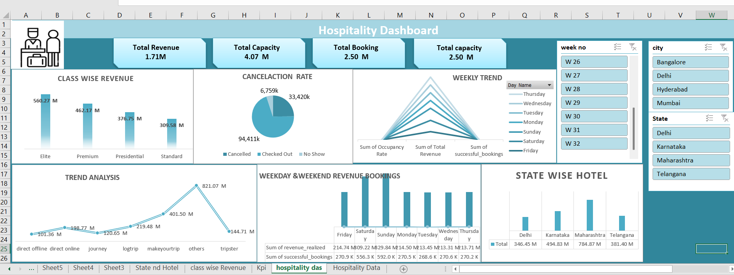
Screenshots of Dashboard

Slide 7
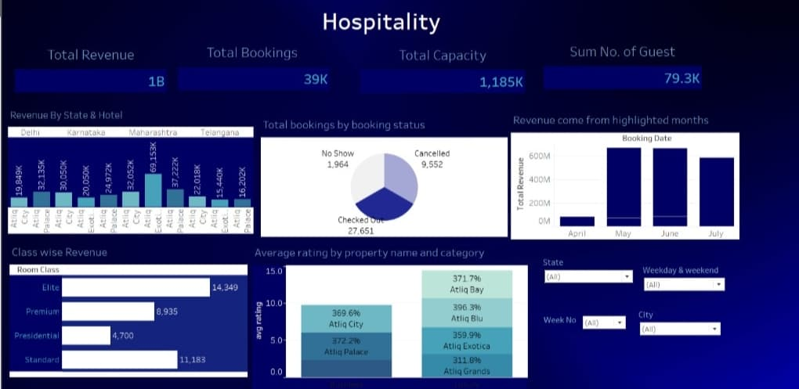

Slide 8
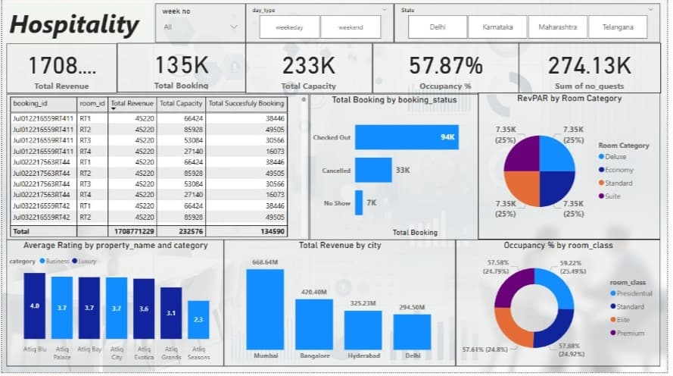

Slide 9
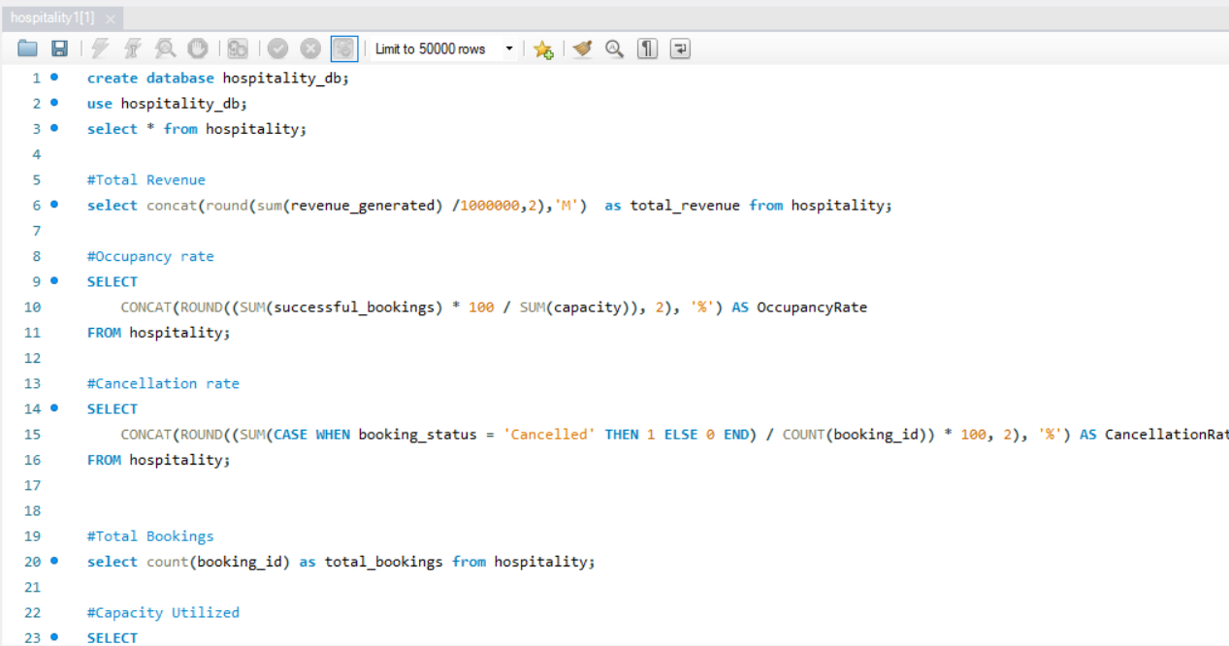
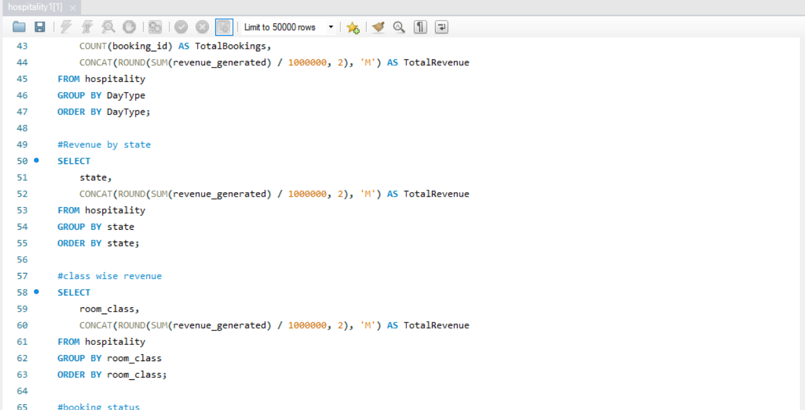
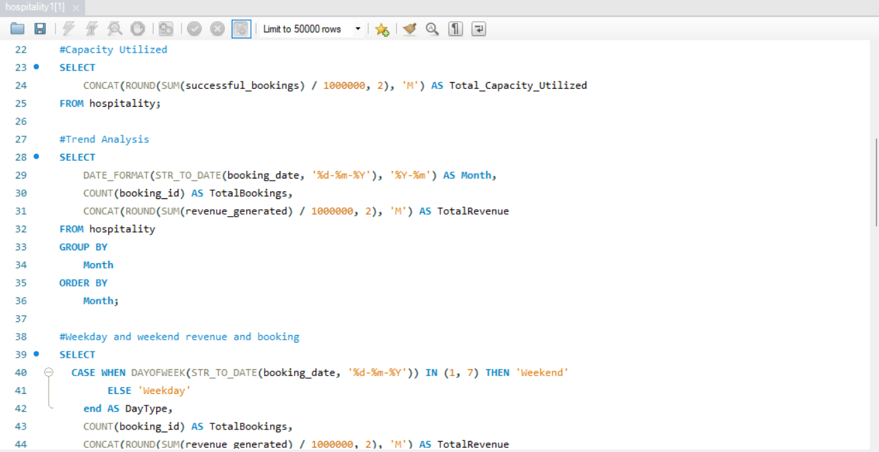
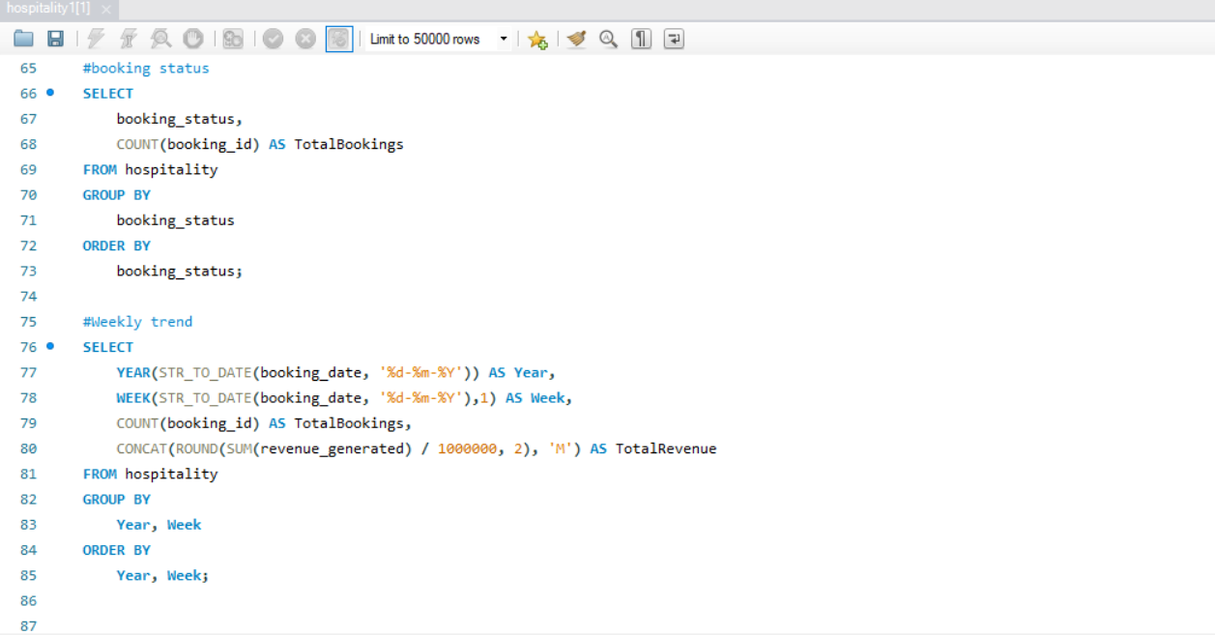

Slide 10
Recommended and conclude
Insights : Weekends showed higher occupancy and revenue across luxury hotels.
Most cancellations occurred 2–3 days before check-in dates.
Some states consistently underperformed due to low seasonal demand.Budget hotels had higher booking volume but lower revenue per room.
Recommendations : Promote weekday discounts to increase occupancy.
Offer loyalty rewards to reduce cancellation rates.
Focus marketing on underperforming states during off- season.
Dynamic pricing for different hotel classes to optimize revenue.
Conclusion : Leveraged data analytics to understand hospitality trends and optimize performance.Multi-tool approach helped build cross-platform dashboards.These insights can guide data-driven strategies for hotel operations.

Slide 11
THANK YOU

